Slide 1
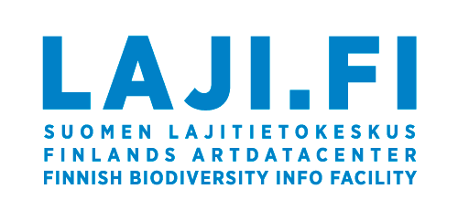
Kotka collection management system

Slide 2
What is Kotka?
System for professionals for managing scientific natural history collections
Botanical, zoological, living, microbial, palaeontological, DNA samples
Built in-house in Luomus since 2011 (Hyntikka 2009), later as part of FinBIF
Web based user interface, no desktop software
Primary system
Open data
Improves data usability, accessibility and persistence
Improves collection management efficiency
Harmonizes collection management practices
National

Slide 3
Users
Used in all big natural history collection organizations in Finland and many small ones
University of Oulu, Biodiversity unit museums
University of Turku, Biodiversity unit museums
University of Jyväskylä, Natural History Museum of Central Finland
Kuopio Natural History Museum
Kieppi, Kokkola Museum of Natural History
The Ark Nature centre, Pori
Ostrobothnian Museum, Vaasa
HAMBI Culture collection, University of Helsinki
The Provincial Museum of Lapland, Rovaniemi

Slide 4
Starting to use Kotka
No fees, Kotka is maintained and developed as part of Luomus national responsibilities
Cooperation agreement
Customer organization gets to know Kotka, Luomus/FinBIF gets to know the data, make a plan
Customer stops using their old system, cleans and transforms the data into Kotka format
Luomus helps and makes necessary changes to Kotka
Luomus imports the data to Kotka, customer starts using Kotka

Slide 5
Overview of features and functionalities
(Show these in Kotka)
Data entry and edit forms
Searches
Transactions: loans, gifts, exchange
Excel generator, export and import
QR code reader app
Printing labels
Saving photos
Statistics and reports
Collection metadata

